Slide 1








ENGLISH
LESSON YEAR 3
MODULE 3- RIGHT NOW

Slide 2





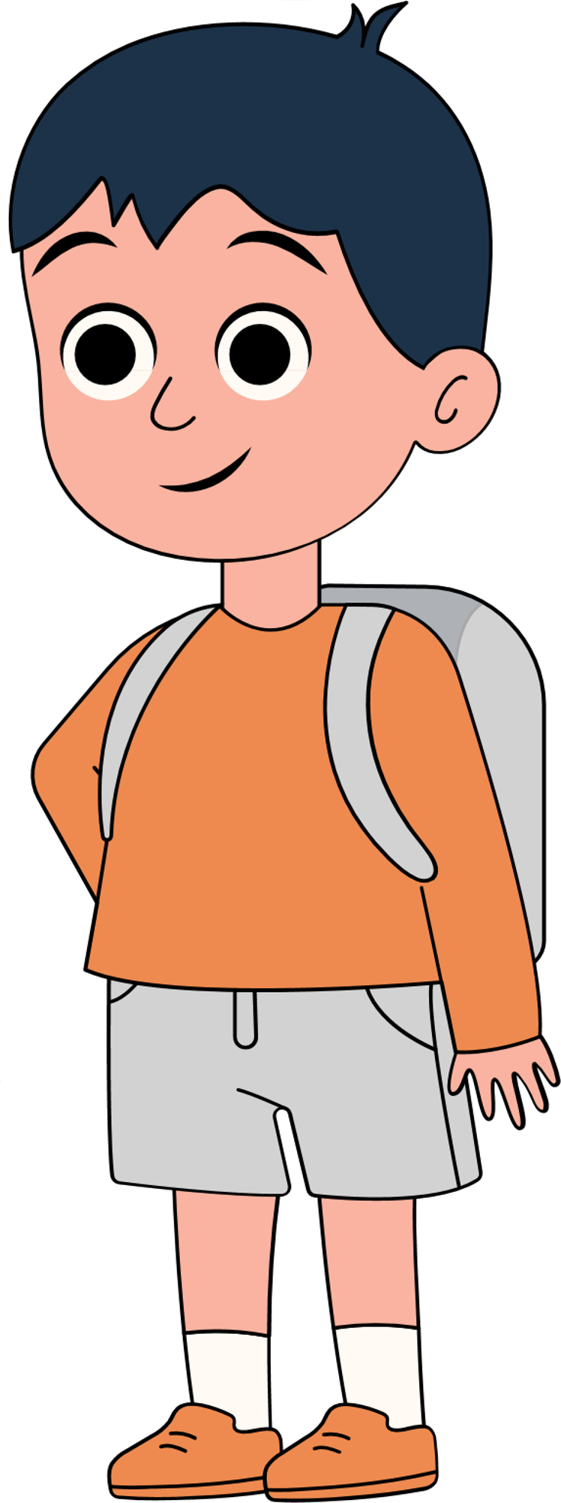


WELCOME, STUDENTS

Slide 3

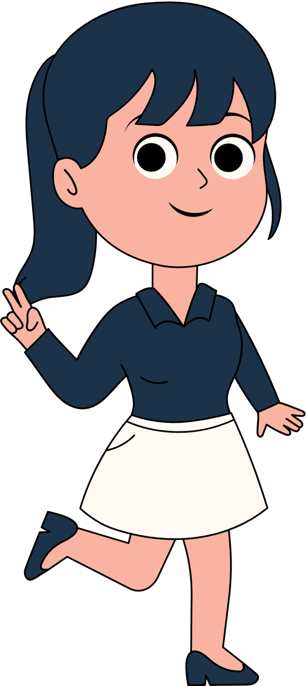









LEARNING
OBJECTIVES
BY THE END OF THE LESSON, PUPILS WILL BE ABLE TO:
Understand with support, specific information and details of short simple texts.
Guess the meaning of unfamiliar words by using visual clues when a teacher or classmate is speaking.

Slide 4




LESSON FOR
THE DAY
TODAY, WE ARE GOING TO LEARN ABOUT PRESENT CONTINUOUS STATEMENTS AND LEARN HOW TO ASK QUESTIONS BASED ON THESE STATEMENTS.

Slide 5



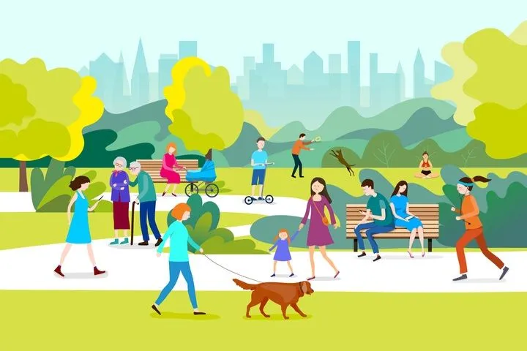


WHAT DO YOU SEE IN THIS PICTURE?

Slide 6








Examples
Example 1
Example 2
They are running.
She is cycling.

Slide 7

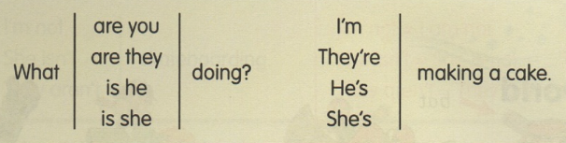
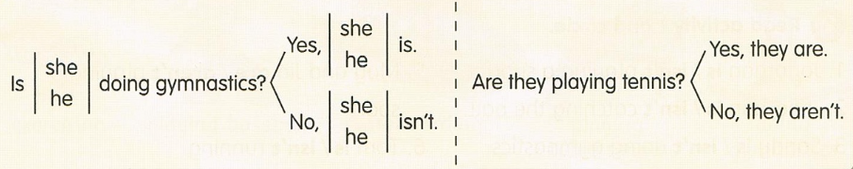

QUESTION & ANSWER

Slide 8

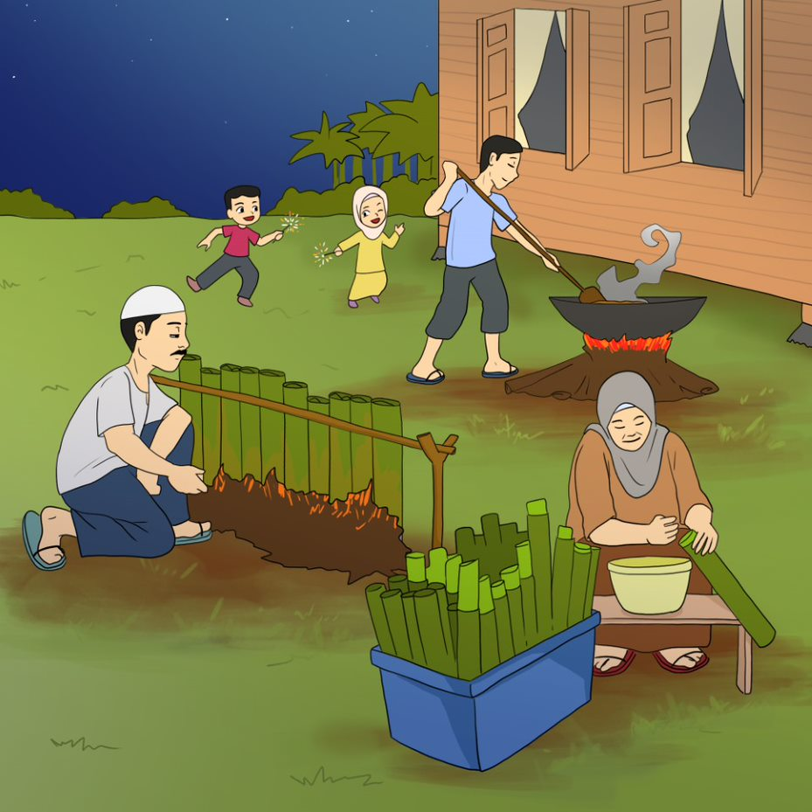
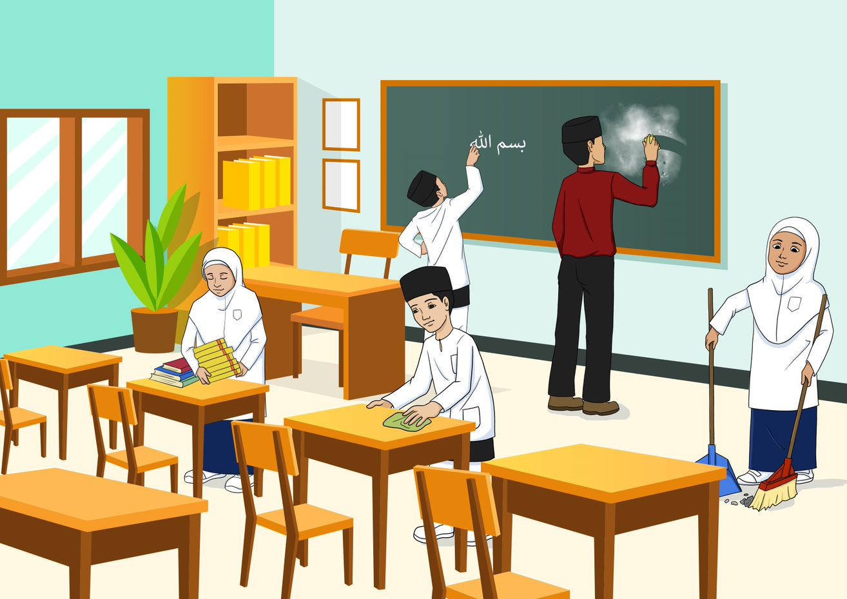

EXERCISE
BASED ON THE PICTURES BELOW, ASK QUESTIONS AND GIVE ANSWERS TO YOUR FRIENDS BY DISCUSSING THE ACTIVITIES THAT ARE TAKING PLACE IN THE PICTURES.

Slide 9

THANK
YOU
SEE YOU NEXT TIME!

